Slide 1



Presented By:
Dr. Alexandra Colon Rodriguez
DEVELOPING LEADERSHIP SKILLS
November 2023

Slide 2

Table Of Content
Content List
01.
03.
Soft & technical skills
Tips - Leadership
02.
04.
Leadership
Personality test

Slide 3

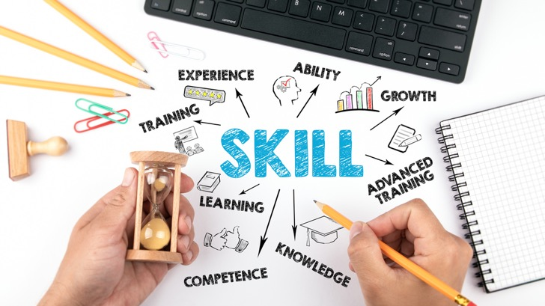
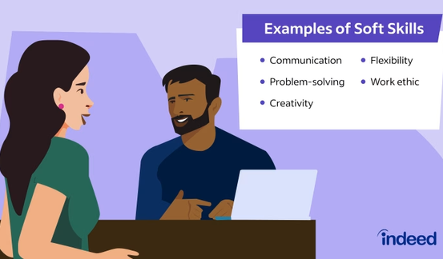
Soft Skills
Definition
personal attributes that enable someone to interact effectively and harmoniously with other people. (Source: Oxford dictionary).
Introduction

Slide 4
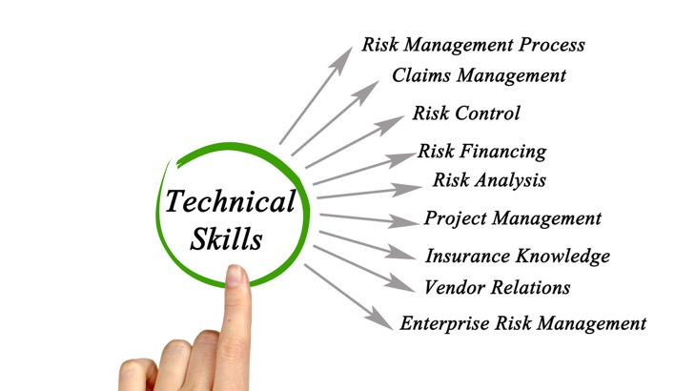
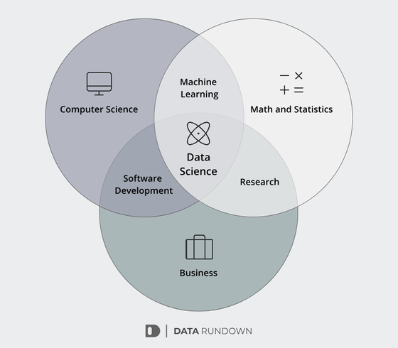
Technical Skills
Definition
relating to the knowledge, machines, or methods used in science (Source: Cambridge dictionary).
Introduction

Slide 5
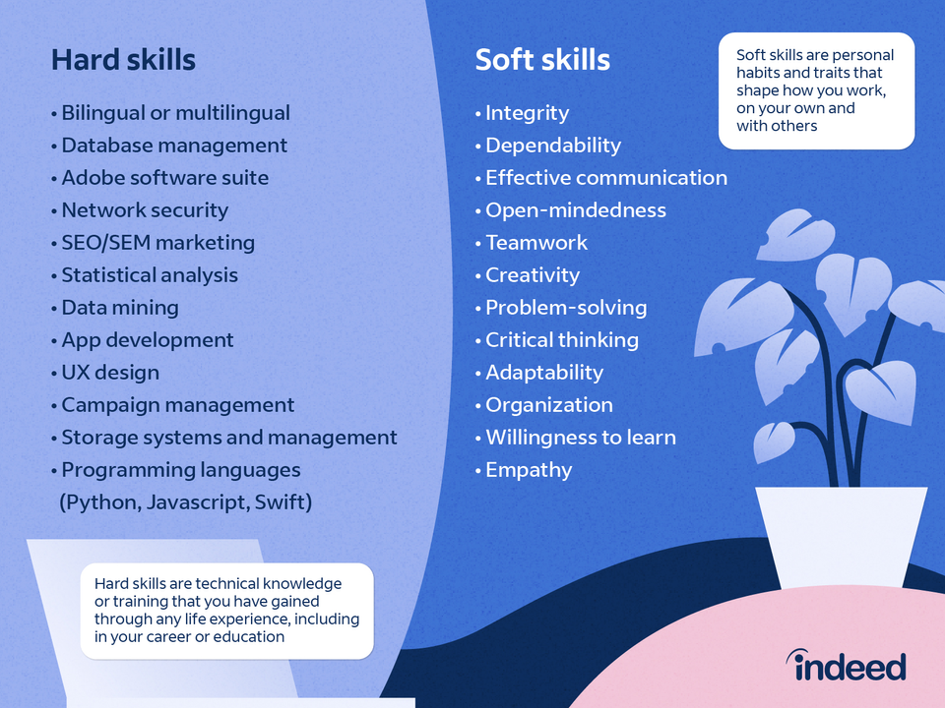

Slide 6
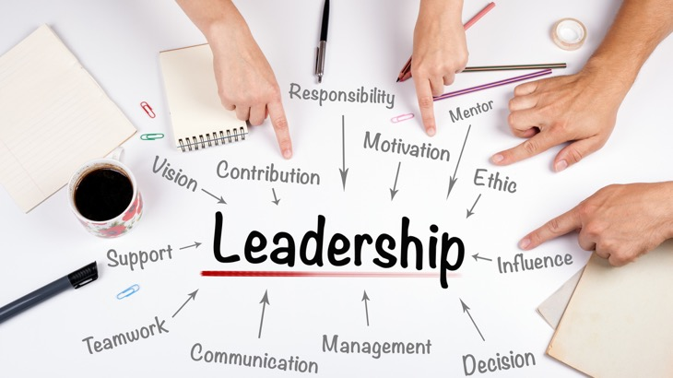
Leadership
Definition
the state or position of being a leader. (Source: Oxford dictionary).
the action of leading a group of people or an organization. (Source: Oxford dictionary).
Introduction

Slide 7
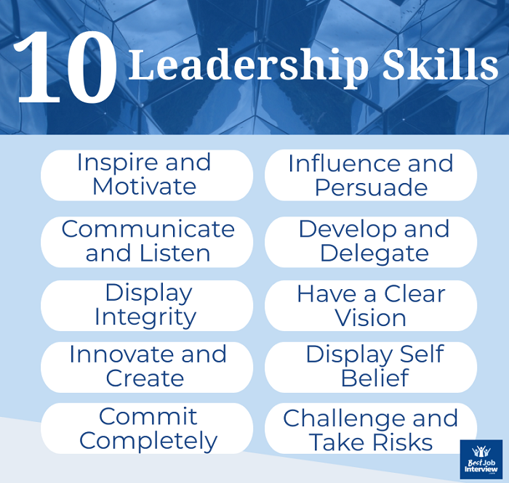

Slide 8
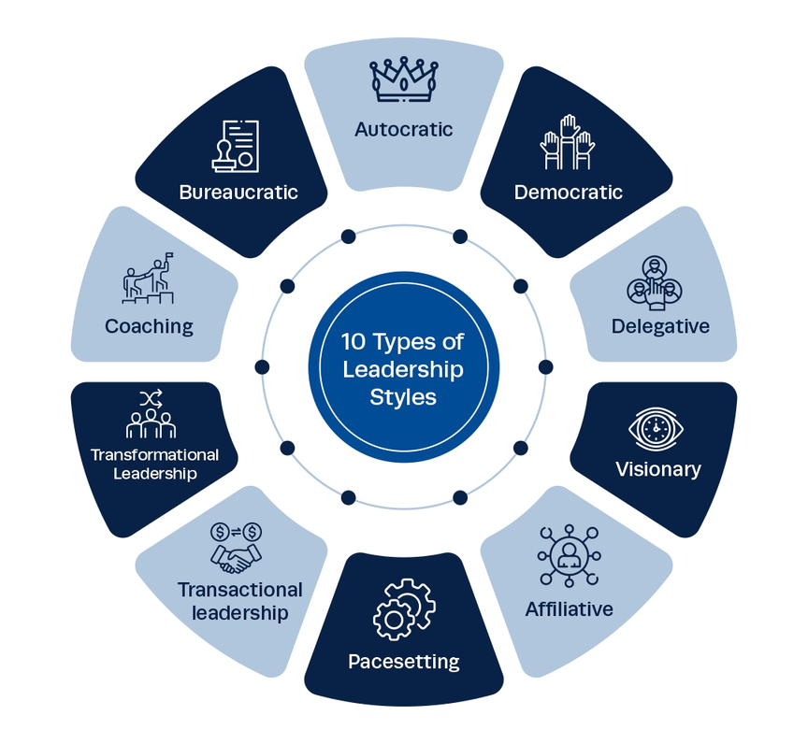
Source: https://instituteprojectmanagement.com/blog/leadership-styles/

Slide 9
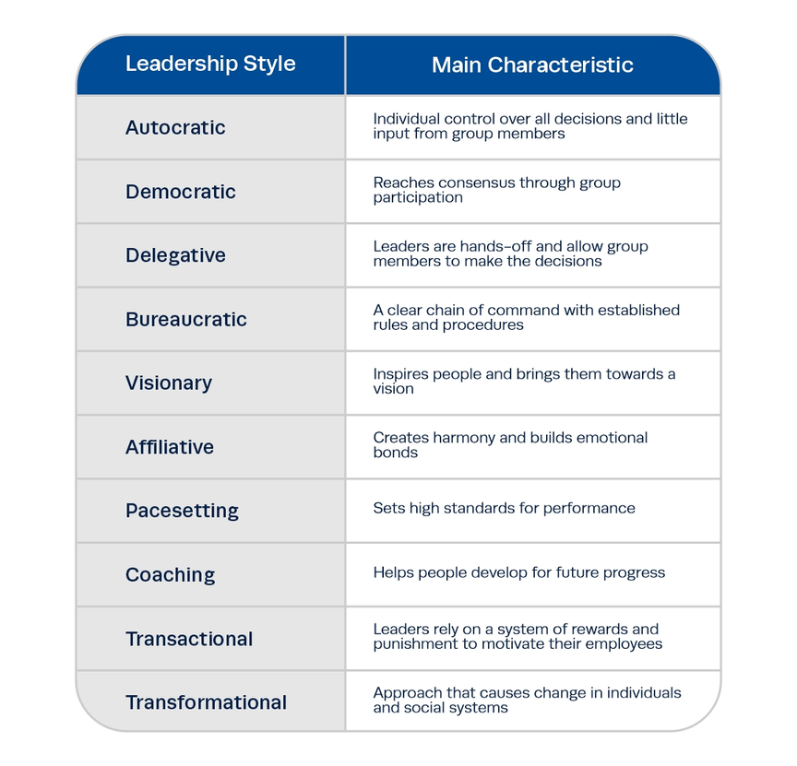
Source: https://instituteprojectmanagement.com/blog/leadership-styles/

Slide 10

Tips
1. Identify your strengths and weaknesses.
2. Understand leadership styles.
3. Target specific skills.
4. Expand your network.
5. Get a coach or mentor.
6. Read and research.
7. Take on leadership roles in your current position.
8. Practice.
Developing Leadership Skills
Source: https://www.coursera.org/enterprise/articles/tips-for-developing-leadership-skills

Slide 11
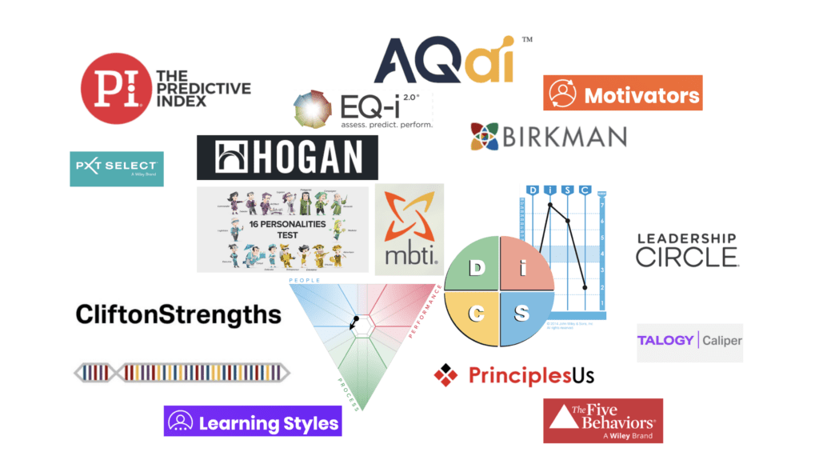
Personality Tests
Source: https://internalchange.com/list-of-personality-tests-and-personal-development-assessments/

Slide 12
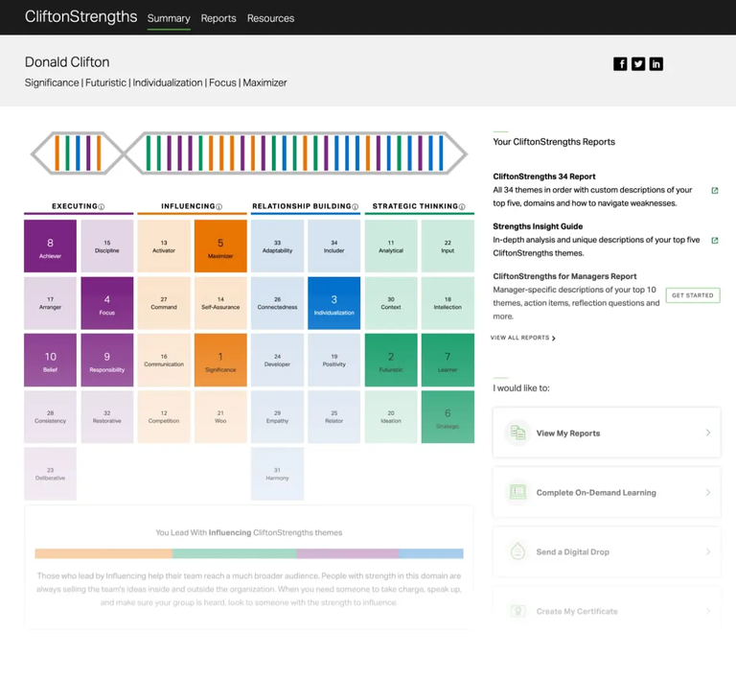

Clifton

Slide 13
Presented By:
Dr. Alexandra Colon Rodriguez
DEVELOPING LEADERSHIP SKILLS
November 2023

